Slide 1
Architectural Patterns-1
UNIT 4

Slide 2
Agenda
Introduction
From mud to structure:-
Layers
Pipes and Filters
Blackboard

Slide 3
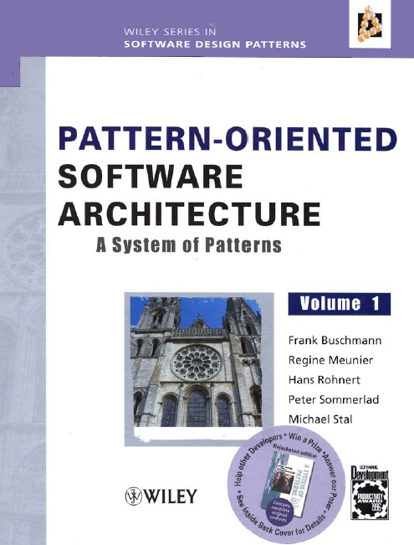
Reference

Slide 4
Introduction
Design Pattern defn.:
A design pattern provides a scheme for refining the subsystems or components of a software system, or the relationships between them.
It describes a commonly-recumng structure of communicating components that solves a general design problem within a particular context
Design patterns are medium-scale patterns. They are smaller in scale than architectural patterns
Each pattern is a three-part rule, which expresses a relation between a certain context, a problem, and a solution

Slide 5
Ex: MVC
A pattern addresses a recurring design problem that arises in specific design situations, and presents a solution to it.
In our example here the problem is supporting variability in user interfaces.
This problem may arise when developing software systems -with human-computer interaction.
You can solve this problem by a strict separation of responsibilities: the core functionality of the application is separated from its user interface.

Slide 6
MVC…
The model component encapsulates core data and functionality. The model is independent of specific output representations or input behavior.
View components display information to the user. A view obtains the data it displays from the model. There can be multiple views of the model.
Each view has an associated controller component. Controllers receive input, usually as events that denote mouse movement, activation of mouse buttons or keyboard input.
Events are translated to service requests, which are sent either to the model or to the view. The user interacts with the system solely via controllers.

Slide 7
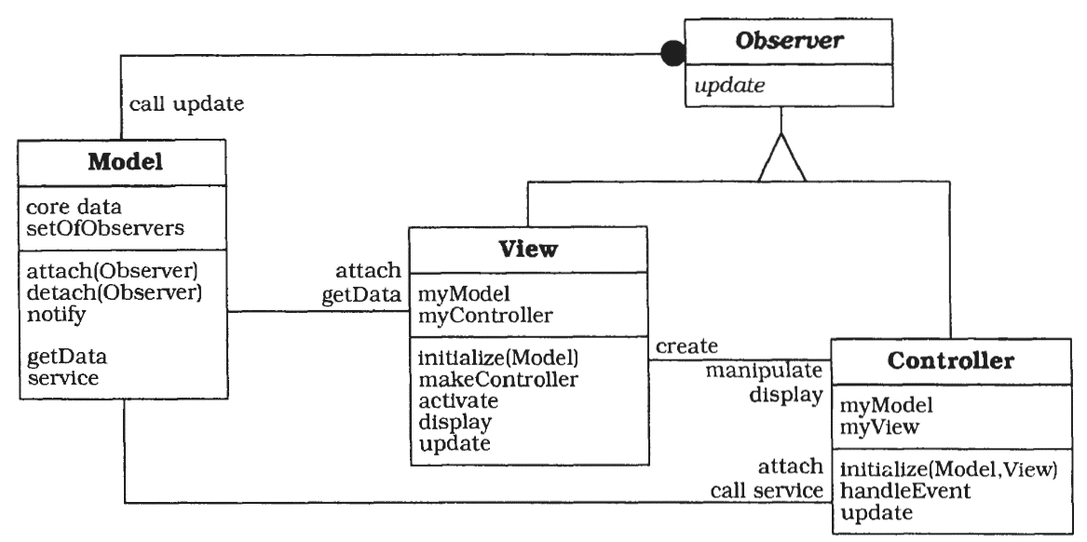
MVC…

Slide 8
Pattern Categories
Architectural Patterns: They are templates for concrete software architecture. They lay down the structural specification of the system and also determine the architecture of the sub systems and specify their responsibilities.
Design Patterns: Are medium scale patterns. They provide the schema for refining the sub systems or the components of the software system. They are smaller in scale than the architectural patterns but tend to be independent of the programming language used.
Idioms: Are the lowest level of patterns. They describe how to implement the particular aspects of the components. Idioms address both the design and the implementation issues of the components

Slide 9
What Makes a Pattern?
Context: a situation giving rise to a problem.
Ex: 'developing software with a human-computer interface.'
Problem: the recurring problem arising in that context.
Ex: The Model-View-Controller pattern, for example, addresses the problem that user interfaces often vary.
Solution: a proven resolution of the problem.
Ex: 'Divide an interactive application into the three areas: processing, output, and input.'

Slide 10
From Mud to Structure
Step 1: collect the requirements from the customer and transform them into specifications.
Step 2: define the architecture of the system. i.e. high-level subdivision of the system into constituent parts
Layers
Pipes and Filters
Blackboard.

Slide 11
Layers

Slide 12
(1) Layers
Defn…
The Layers architectural pattern helps to structure applications that can be decomposed into groups of subtasks in which each group of subtasks is at a particular level of abstraction
Ex: Network protocol

Slide 13


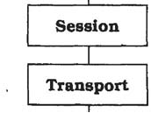
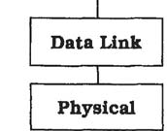
N/w Layer
Network

Slide 14
Layered Pattern
Context: A large system that requires decomposition.
Problem: Imagine that you are designing a system whose dominant characteristic is a mix of low- and high-level issues, where high-level operations rely on the lower-level ones.
Solution: Structure your system into an appropriate number of layers and place them on top of each other. Start at the lowest level of abstraction-call it Layer 1 and upwards to Layer N.
Structure: An individual layer can be described by the following CRC card:

Slide 15
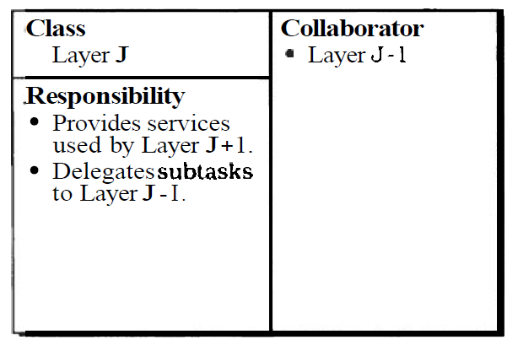
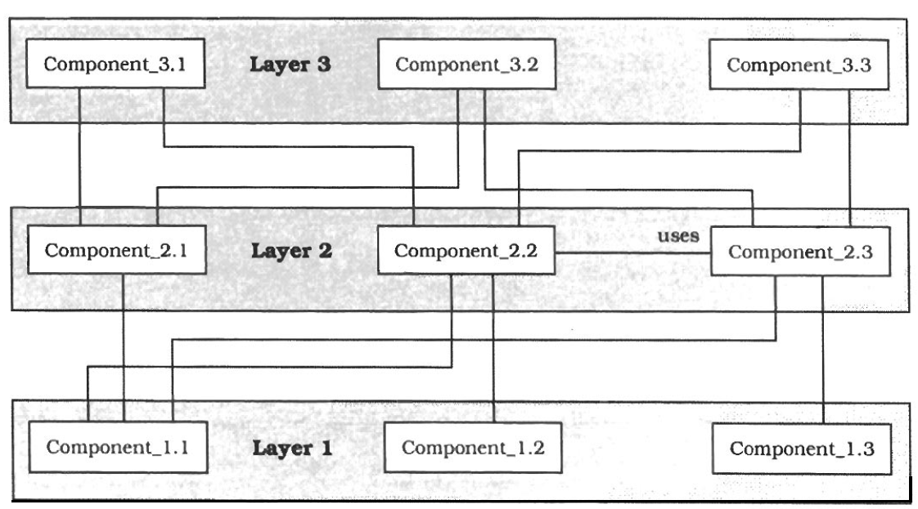
Structure (Contd.)
Structure: An individual layer can be described by the following CRC card:

Slide 16
Dynamics
The following scenarios are archetypes for the dynamic behavior of layered applications.
Scenario I
A client Issues a request to Layer N. Since Layer N cannot carry out the request on its own, it calls the next Layer N - 1 for supporting subtasks & it does provide. This continues up to Layer 1.
Scenario II
bottom-up communication - starts at Layer 1, and up to layer N
Scenario III
describes the situation where requests only travel through a subset of the layers

Slide 17
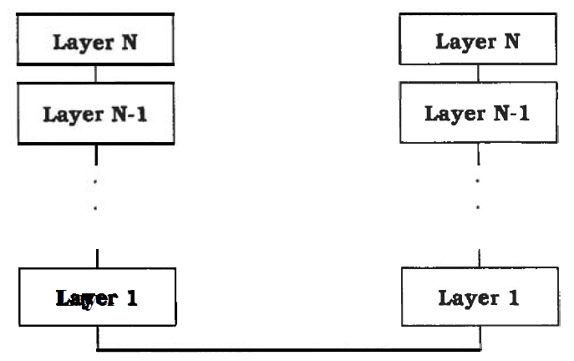
Contd.
Scenario V

Slide 18
Implementation
(1) Define the abstraction criterion for grouping tasks into layers
Ex: chess game:
Elementary units of the game, such as a bishop Basic moves, such as castling
Medium-term tactics, such as the Sicilian defense
Overall game strategies
(2) Determine the number of abstraction level
Think about the trade-offs when deciding whether to split particular aspects into two layers or combine them into one.
(3) Name the layers and assign tasks to each of them
(4) Specify the services

Slide 19
Contd.
(5) Refine the layering. Iterate over steps 1 to 4.
(6) Specify an interface for each layer.
(7) Structure individual layers: When an individual layer is complex it should be broken into separate components
(8) Specify the communication between adjacent layers
(9) Decouple adjacent layers
The 'wiring' of the layers is done here in the main program, but will usually be factored out into a connection management component. The main program also takes the role of the client by calling a service in the top layer
(10) Design an error-handling strategy

Slide 20
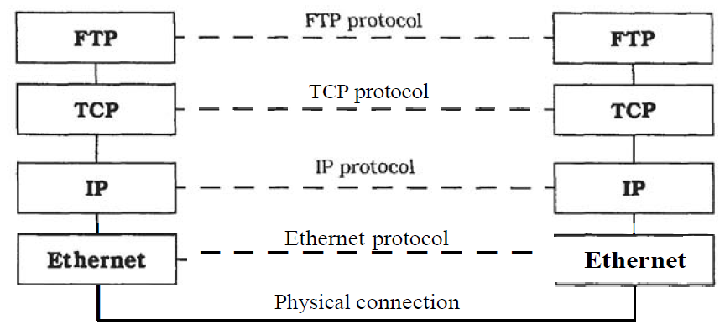
Example Resolved
A typical configuration, that for the UNIX ftp utility is shown below:

Slide 21
Variants
Relaxed Layered System This is a variant of the Layers pattern that is less restrictive about the relationship between layers.
In a Relaxed Layered System each layer may use the services of all layers below it, not only of the next lower layer
Layering Through Inhetitance

Slide 22
Known Uses
Virtual Machines – JVM
API
IS (DBMS) : 2 layered or 3 layerd

Slide 23
Consequences
Benefits
Reuse of layers
Support for standardization
Dependencies are kept local
Exchangeability

Slide 24
Pipes and Filters

Slide 25
(2) Pipes and Filters Introduction
The Pipes and Filters architectural pattern provides a structure for systems that process a stream of data.
Each processing step is encapsulated in a filter component.
Data is passed through pipes between adjacent filters
Example: New Programming Language
Mocha - Modular Object Computation with Hypothetical Algorithms.
AuLait - Another Universal Language for Intermediate Translation (IL)
Cup - Concurrent Uniform Processor - virtual machine

Slide 26
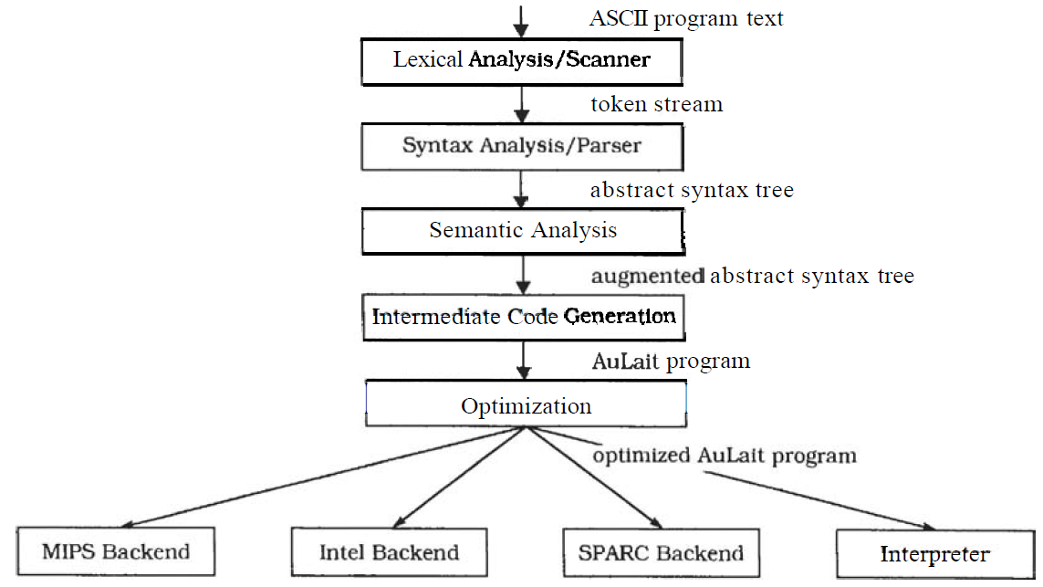
Example

Slide 27
Pipes-and-Filters
Context: Processing data streams.
Problem: Imagine you are building a system that must process or transform a stream of input data
Note: an interactive, event-driven system does not split into sequential stages.
Solution: It divides the task of a system into several sequential processing steps. These steps are connected by the data flow through the system-the output data of a step is the input to the subsequent step. Each processing step is implemented by a filter component
Structure: Filter components are the processing units of the pipeline

Slide 28
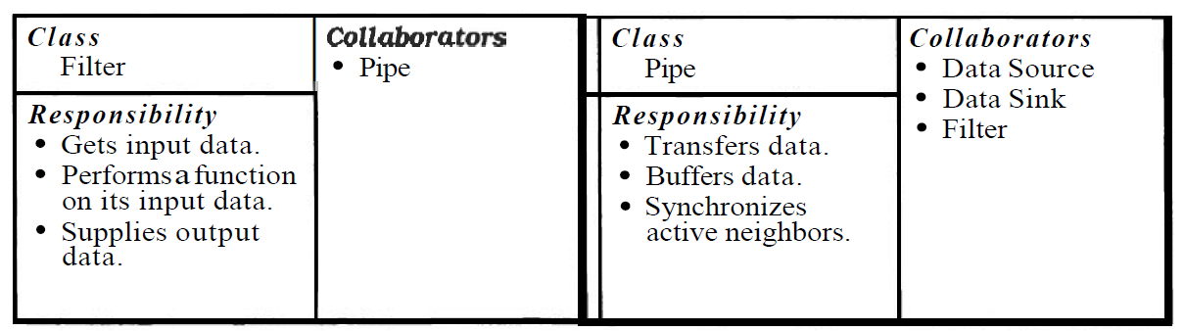
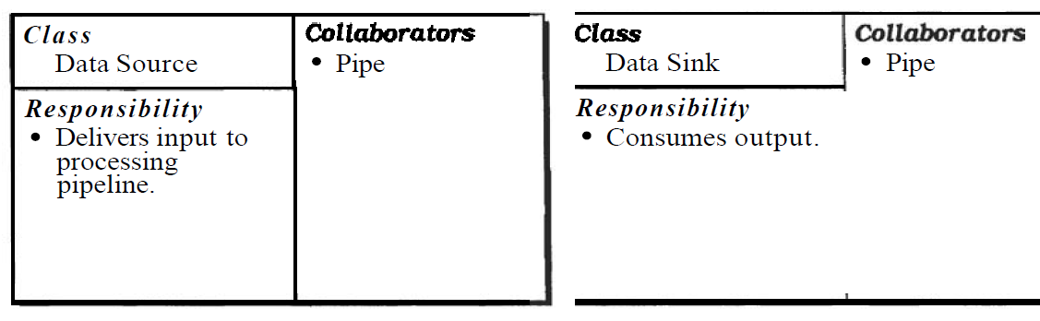
Contd.

Slide 29
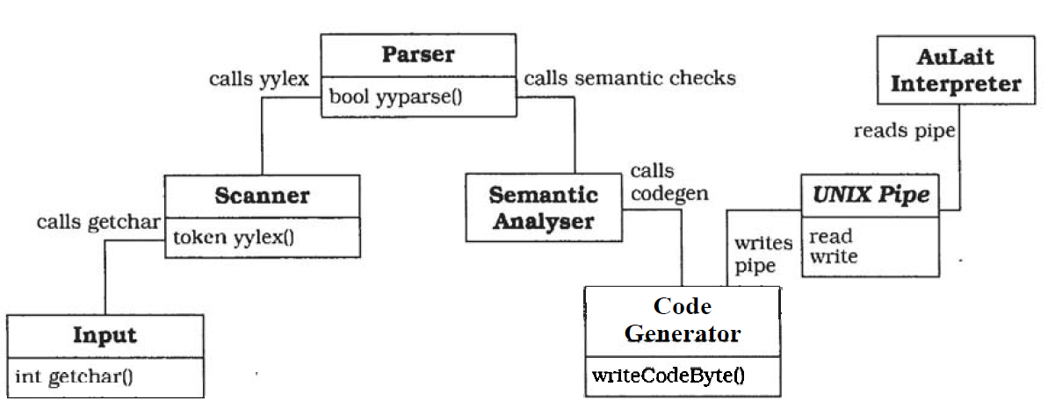
Example

Slide 30
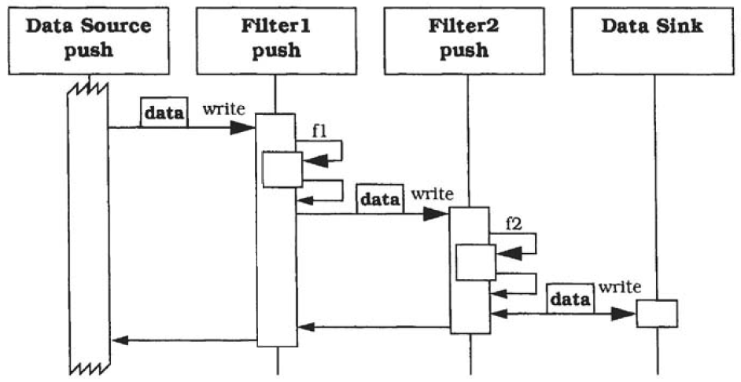
Dynamics
Scenario I: push pipeline in which activity starts with the data source. Filter activity is triggered by writing data to the passive filters.

Slide 31
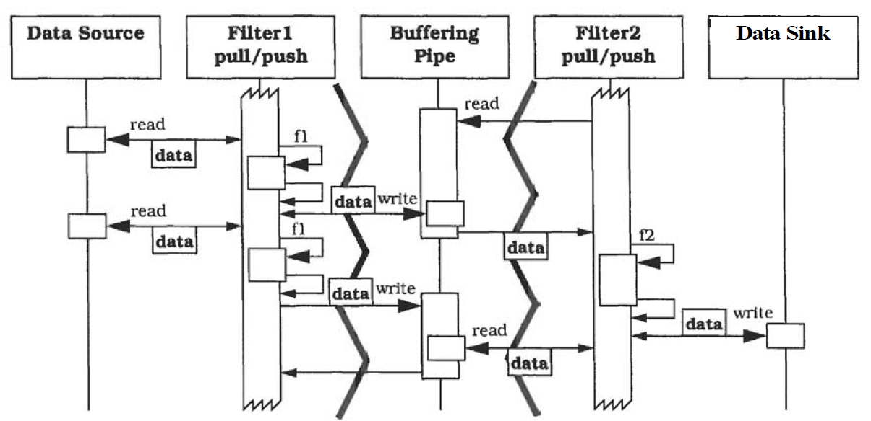
Scenario IV

Slide 32
Scenario IV…
All filters actively pull, compute, and push data in a loop. Each filter therefore runs in its own thread of control, for example as a separate process.
The filters are synchronized by a buffering pipe between them.
Filter 2tries to get new data by reading from the pipe. Because no data is available the data request suspends the activity of Filter 2-the buffer is empty.
Filter 1 pulls data from the data source and performs function f 1 & pushes the result to the pipe.
Filter2 can now continue, because new input data is available.
Filter 1 can also continue, because it is not blocked by a full buffer within the pipe.
Filter 2 computes f2 and writes its result to the data sink.
In parallel with Filter 2’s activity, Filter 1 computes the next result and tries to push it down the pipe. This call is blocked because Filter 2 is not waiting for data-the buffer is full.
Filter 2 now reads new input data that is already available from the pipe. This releases Filter 1 so that it can now continue its processing.

Slide 33
Implementation
Divide the system’s tasks into a sequence of processing stages.
Each stage must depend only on the output of its direct predecessor.
All stages are conceptually connected by the data flow.
Define the data format to be passed along each pipe.
Defining a uniform format results in the highest flexibility because it makes recombination of its filters easy.
You must also define how the end of input is marked.
Decide how to implement each pipe connection.
Filters are active or passive components.
Adjacent pipes - push or pull of data.
Design and implement the filters.
Task it must perform and on the adjacent pipes.
Passive filters as a function – push/pull for activation
Active filters can be implemented either as processes or as threads in the pipeline program

Slide 34
Contd.
Design the error handling
Because the pipeline components do not share any global state, error handling is hard to address and is often neglected.
As a minimum, error detection should be possible. UNIX defines specific output channel for error messages, standard error.
If a filter detects error in its input data, it can ignore input until some clearly marked separation occurs.
It is hard to give a general strategy for error handling with a system based on the pipes and filter pattern.
Set up the processing pipeline
If your system handles a single task you can use a standardized main program that sets up the pipeline and starts processing.
You can increase the flexibility by providing a shell or other end-user facility to set up various pipelines from your set of filter components.

Slide 35
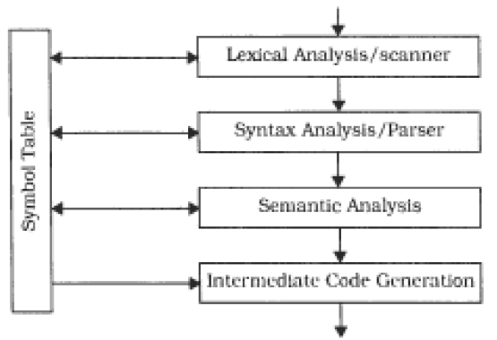
Example resolved
We combined the first four compiler phases into a single program because they all access and modify the symbol table.

Slide 36
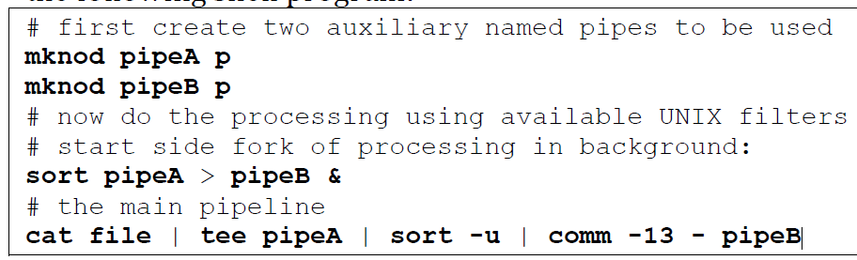
Variants
Tee and join pipeIine systems
Pipes and Filters pattern can be varied to allow filters with more than one input and/or more than one output
For example, to build a sorted list of all lines that occur more than once In a text file. we can construct the following shell program:

Slide 37
Known Uses
UNIX [Bac86] popularized the Pipes and Filters paradigm. The flexibility of UNIX pipes made the operating system a suitable platform for the binary reuse of filter programs and for application integration.
CMS Pipelines [HRV95] is an extension to the operating system of IBM mainframes to support Pipes and Filters architectures. It provides a reuse and integration platform in the same way as UNIX.
LASSP Tools [Set95] is a toolset to support numerical analysis and graphics. The toolset consists mainly of filter programs that can be combined using UNIX pipes.

Slide 38
Consequences - Benefits
No intermediate files necessary, but possible
Flexibility by the filter change
Flexibility by recombination
Reuse of filter components
Rapid prototyping of pipelines
Efficiency by parallel processing

Slide 39
Drawbacks
Sharing state information is expensive or inflexible
Efficiency gain by parallel processing is often an illusion
Data transformation overhead
Error handling

Slide 40
Blackboard

Slide 41
(3) BLACKBOARD
The blackboard architectural pattern is useful for problems for which no deterministic solution strategies are known. In blackboard several specialized subsystems assemble their knowledge to build a possibly partial or approximate solution.
Example
Consider a software system for speech recognition. The input to the system is speech recorded as a waveform.
The system not only accepts single words, but also whole sentences that are restricted to the syntax and vocabulary needed for a specific application, such as a database query.
The desired output is a machine representation of the corresponding English phrases.

Slide 42
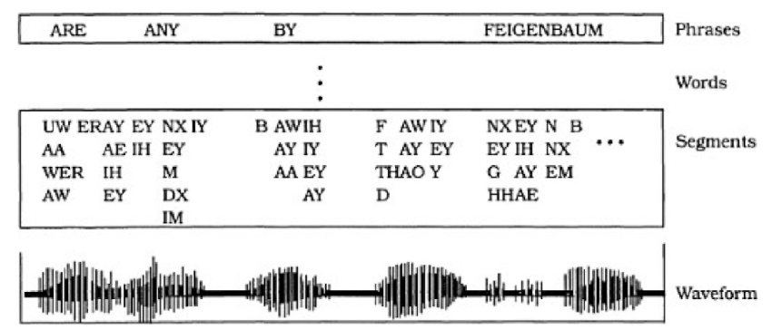
Example
Output
Input

Slide 43
Blackboard…
Context: An immediate domain in which no closed approach to a solution is known or feasible
Problem: The Blackboard pattern tackles problems that do not have a feasible deterministic solution for the transformation of raw data into high level data structures, such as diagrams, tables or English phrases.
Vision, image recognition, speech recognition and surveillance are examples of domains in which such problems occur.

Slide 44
Solution
The idea behind the Blackboard architecture is a collection of independent programs that work cooperatively on a common data structure.
Each program is specialized for solving a particular part of the overall task, and all programs work together on the solution.
These specialized programs are independent of each other.
They do not call each other, nor is there a predetermined sequence for their activation.
The name 'blackboard’ was chosen because it is meaningful of the situation in which human experts sit in front of a real blackboard and work together to solve a problem.

Slide 45
Structure
Divide your system into a component called a blackboard, a collection of knowledge sources, and a control component.
Blackboard is the central data store.
Elements of the solution space and control data are stored here.
Set of all data elements that can appear on the blackboard are referred to as vocabulary.
Blackboard provides an interface that enables all knowledge sources to read form and write to it.

Slide 46
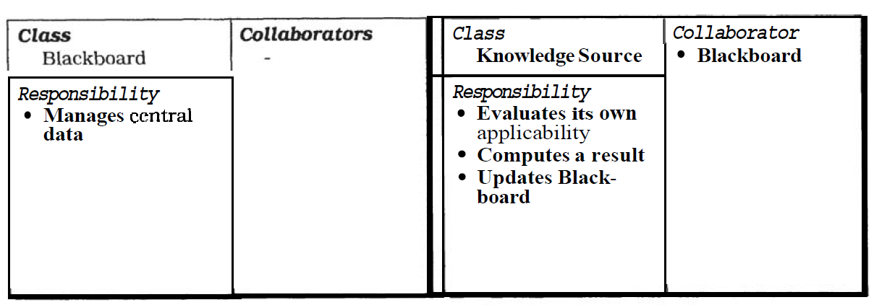
Contd.
Each knowledge source is responsible for knowing the conditions under which it can contribute to a solution.

Slide 47
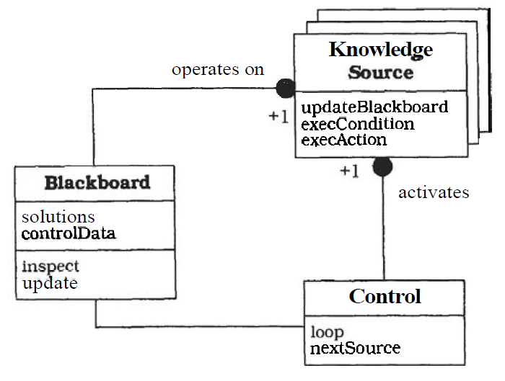
Contd.
The Control component runs a loop that monitors changes on the blackboard and decides what actions to take next

Slide 48
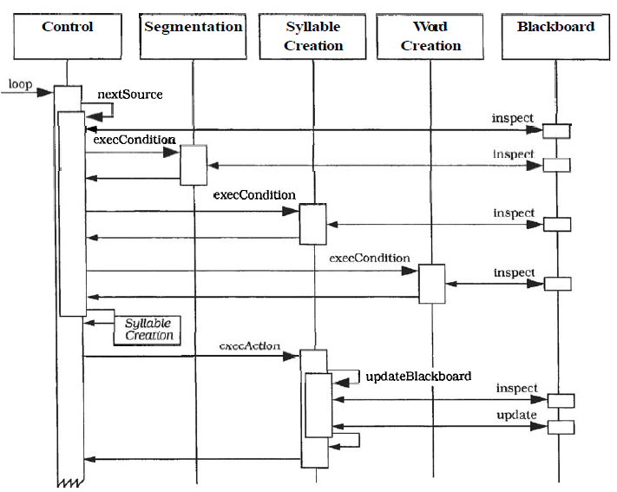
Dynamics
Scenario - illustrates the behavior of the Blackboard architecture
The action-part of Syllable* Creation inspects the state of the blackboard, creates a new syllable and updates the blackboard.
* the word water is composed of two syllables: wa and ter

Slide 49
Implementation
Define the problem
Define the solution space for the problem
Divide the solution process into steps.
Divide the knowledge into specialized knowledge
Define the vocabulary of the blackboard
Implement the knowledge sources

Slide 50
Variants
Production systems: used in oops language. Here the subroutines are represented as condition-action rules, and data is globally available in working.
Repository: it is a generalization of blackboard pattern the central data structure of this variant is called a repository.

Slide 51
Summary

